Slide 1
3D Visualization of 2D/360° Image and Navigation in Virtual Reality through motion processing via smart phone sensors
Group Members:
Maliha Tasnim Aurini
Shitab Mushfiq-ul Islam
Supervised by:
Dr. Md. Ashraful Alam

Slide 2
OBJECTIVE
Improve Virtual Reality Experience
Computer generated depth image
Creating a navigation system using internal sensors of smartphones
Navigate (z-axis) on a 2D image virtually
Optimum experience on Virtual Reality

Slide 3
MOTIVATION
Need for Interactive Virtual Reality content
Conversion of 2D image into 3D visual
Cutting the data cost of visual information (Replacing 3D elements with 2D images)
Cutting the cost of external sensors for navigation and movement
Contribution to smartphone VR

Slide 4
BACKGROUND STUDY
Background Study
Image processing
VR navigation

Slide 5
BACKGROUND STUDY (Image Processing)
Kinect sensor for depth image
3D histogram-based segmentation to refine the depth map
high computed data mining techniques such as Knn
Depth extortion by the focus and defocus cues through higher-order statistics technique
Stereoscopic 3D from 2D video image stitching through fundamental matrix

Slide 6
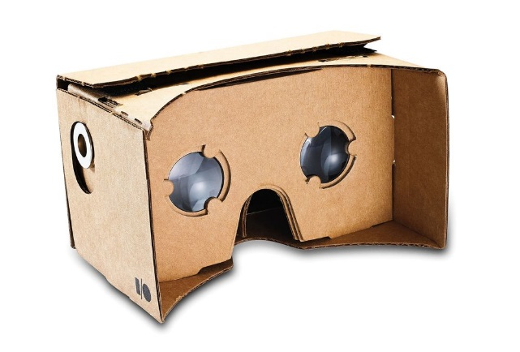
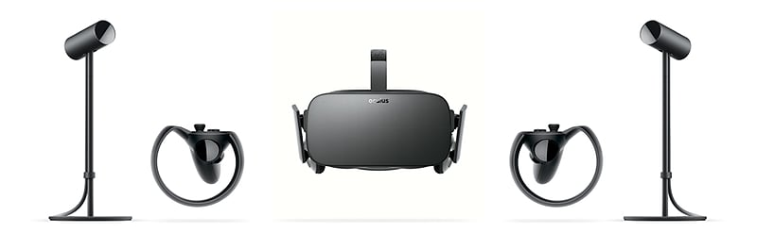
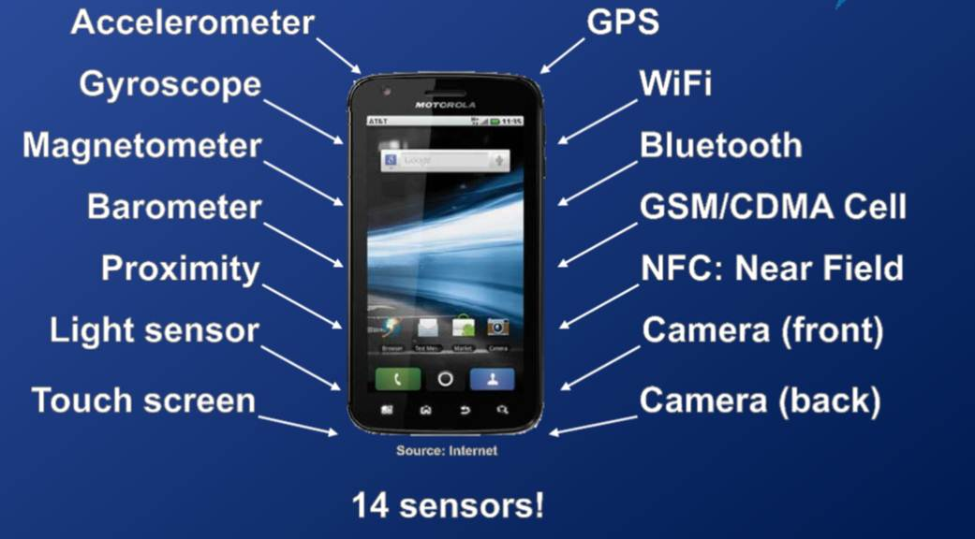
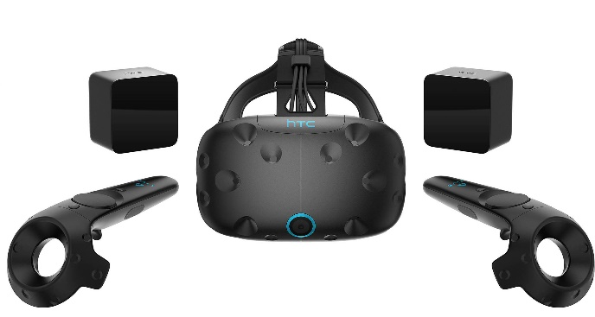
BACKGROUND STUDY (Existing VR Systems)
Figure 1. Google Cardboard headset
Figure 2. Oculus Rift
Figure 4. HTC Vive
Figure 3. Android Sensors

Slide 7
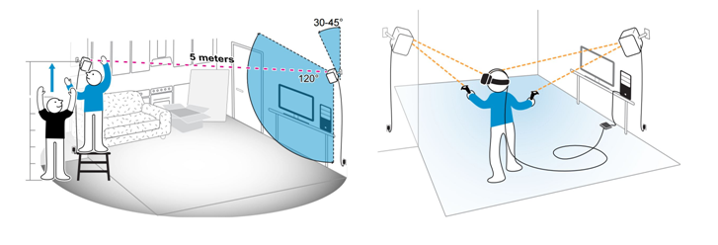

BACKGROUND STUDY (NAVIGATION SYSTEMS)
Figure 5. HTC Vive setup and navigation using base stations
For Navigation and movement detection
>Accelerometer
>Gyroscope
>Proximity Sensor
>GPS
>Camera
Figure 6. Smartphone

Slide 8
PROPOSED MODEL
Input 2D image
Segmenting the into two images
Calculate the Depth map and Depth image
Generating Stereo images
Via any camera
Approximate segmentation to create two images
Calculate depth map from the 2 image cropped images via disparity map
From depth map and 2D image generate stereo pair through shifting pixels
Movement via Accelerometer on the stereo pair
Port the image to VR device
Port the image on head mounted display via Google Cardboard service
Simulating movement accessing the mobile sensors

Slide 9
METHODOLOGY (SEGMENTATION)
Read Image
Z axis remain constant
T_{x} is the base of the eye pair
Segmented new pair’s coordinate
N_{R} = (X₀ –T_{x,} Y₀, Z₀)
Make all the pixels up to baseline
white
Calculate Width Calculate Height Calculate T_{x}
Cut image on horizontal width up to T_{x}
Resize the image by making it white up to deducted width
Segmented Image I2

Slide 10
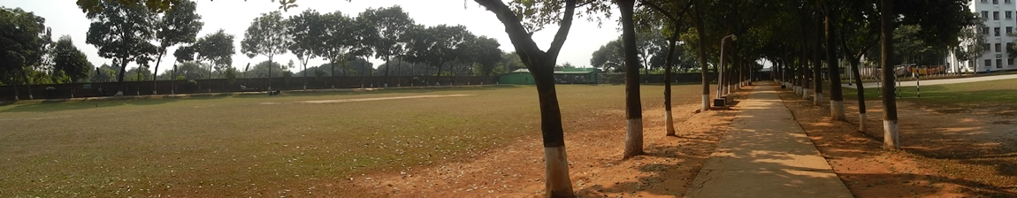
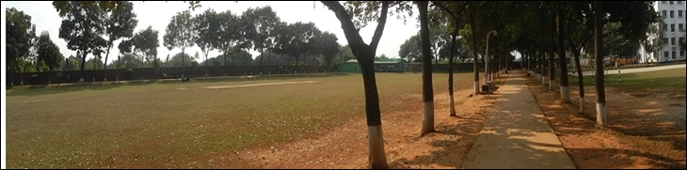
METHODOLOGY (SEGMENTATION)
Figure 5. Ideal Image
Figure 6. Segmented Image

Slide 11


METHODOLOGY (SEGMENTATION)
Figure 7. Ideal Image
Figure 8. Segmented Image

Slide 12
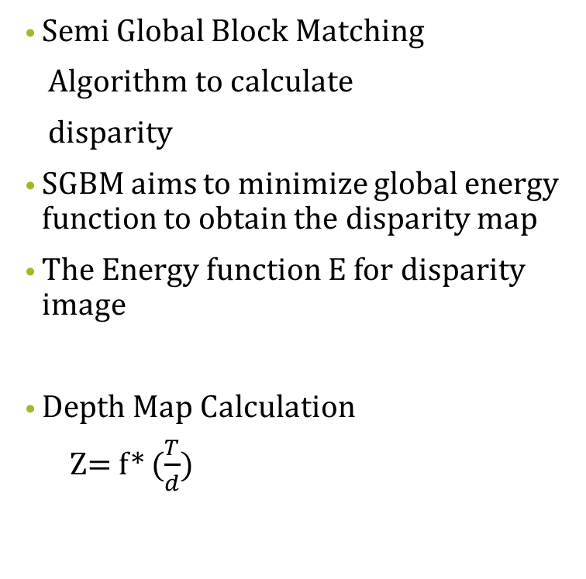
METHODOLOGY (GENERATING DEPTH IMAGE)
Semi Global Block Matching
Algorithm to calculate
disparity
SGBM aims to minimize global energy function to obtain the disparity map
The Energy function E for disparity image
Depth Map Calculation
Z= f* ($\frac{T}{d}$)
Set parameter for SGBM (P1, P2,C)
Calculate disparity Image
Calculate Depth map
Generate Depth Image

Slide 13
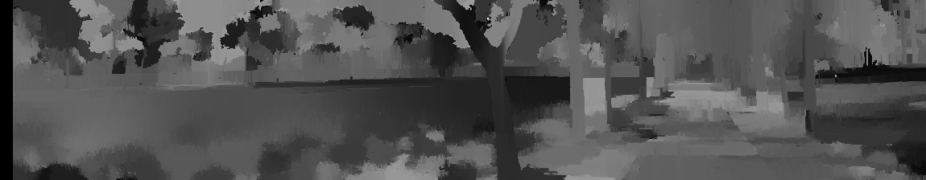
METHODOLOGY (GENERATING DEPTH IMAGE)
Figure 5 .Ideal Image
Figure 10. Depth Image

Slide 14

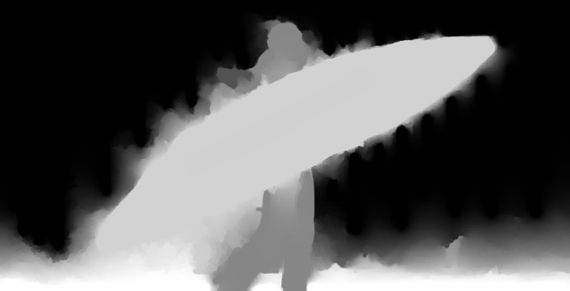
METHODOLOGY (GENERATING DEPTH IMAGE)
Figure 7. Ideal Image
Figure 10. Depth Image

Slide 15
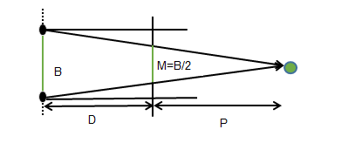
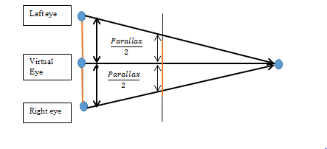
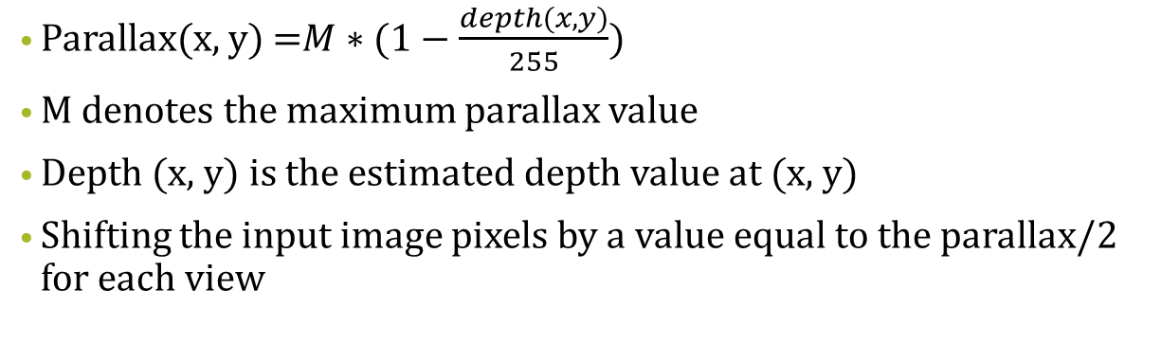
METHODOLOGY (GENERATING STEREO IMAGE)
Figure 11. Parallax with respect to screen
Figure 12. Stereo pair generation
Parallax(x, y) =$M∗(1−\frac{depth(x,y)}{255})$
M denotes the maximum parallax value
Depth (x, y) is the estimated depth value at (x, y)
Shifting the input image pixels by a value equal to the parallax/2 for each view

Slide 16
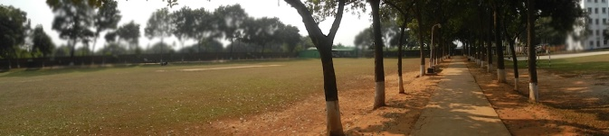
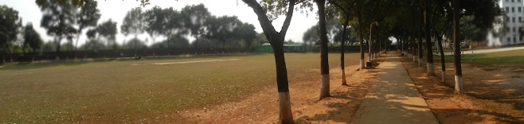
METHODOLOGY (GENERATING STEREO IMAGE)
Figure 13. Left Eye Image
Figure 14. Right Eye Image

Slide 17


METHODOLOGY (GENERATING STEREO IMAGE)
Figure 15. Left Eye Image
Figure 16. Right Eye Image

Slide 18

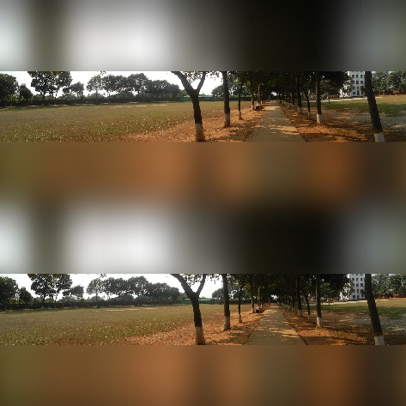
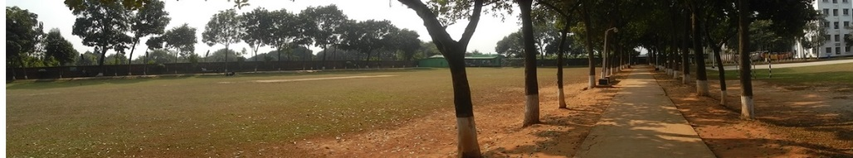
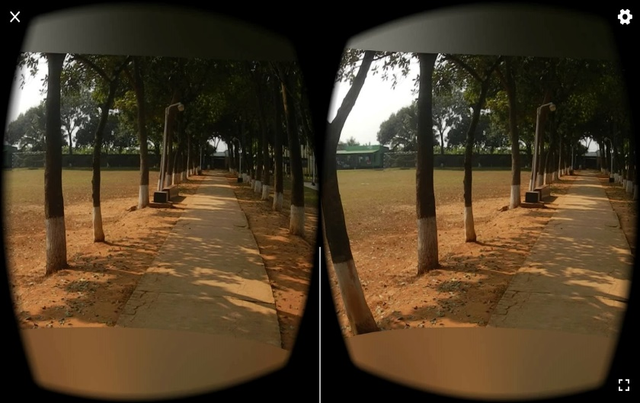
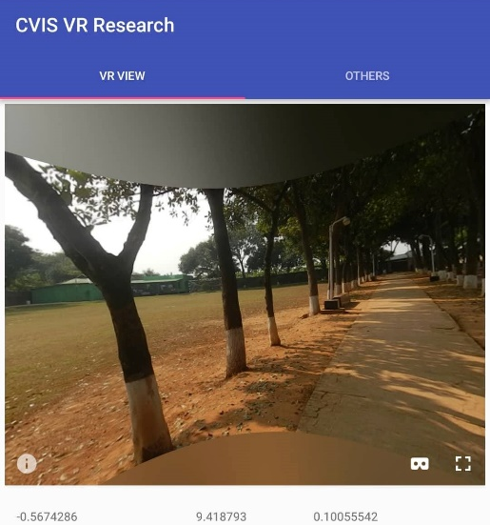
METHODOLOGY (VR INTREGATION ANDROID STUDIO)
1
2
Figure 13. Left eye image
Figure 14. Right eye image
Figure 17. Cardboard Camera image
3
4
Figure 18. Application view
Figure 19. VR view by Android Studio

Slide 19
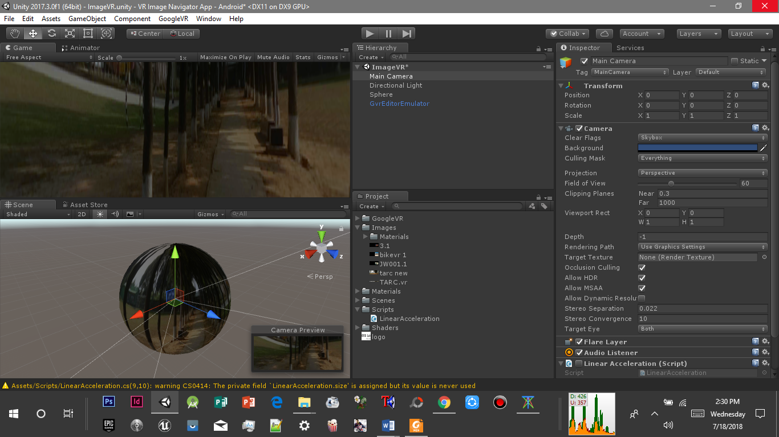
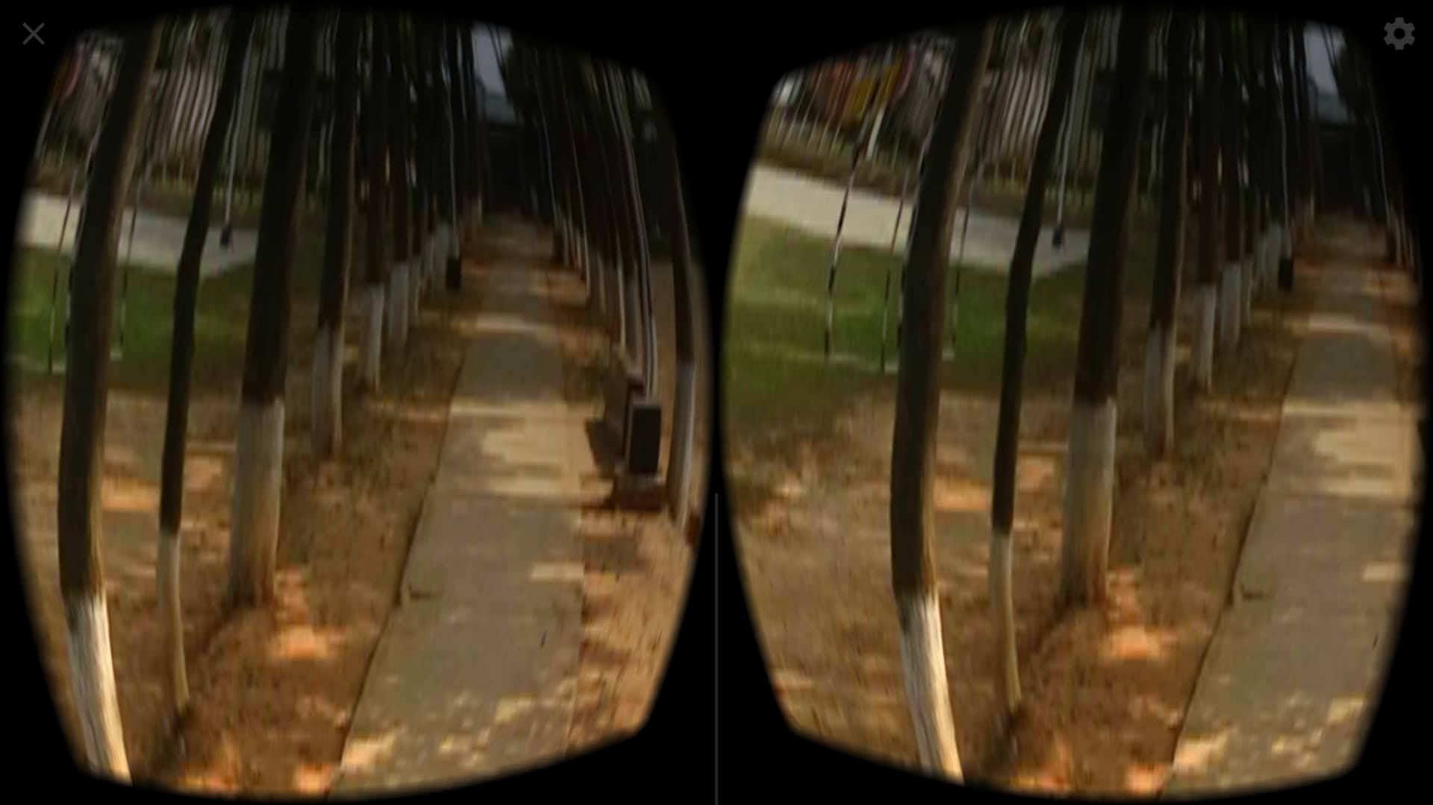
METHODOLOGY (VR INTREGATION UNITY3D)
1
2
Figure 13. Left eye image
Figure 14. Right eye image
3
Figure 20. Using Unity Game assets to develop the application
Figure 21. VR view by Unity3D

Slide 20
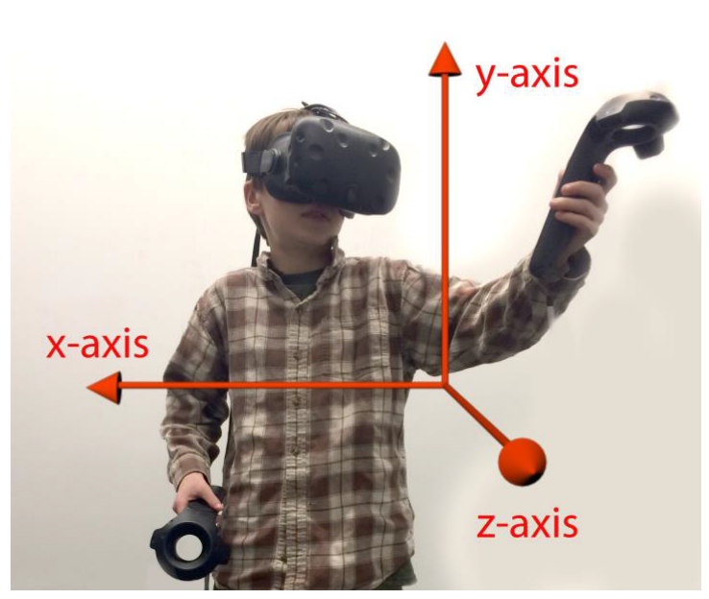
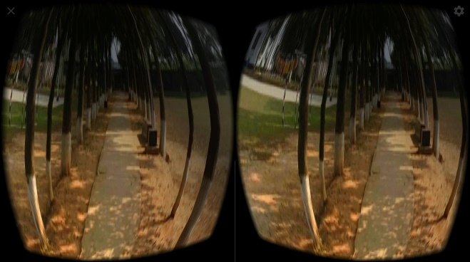
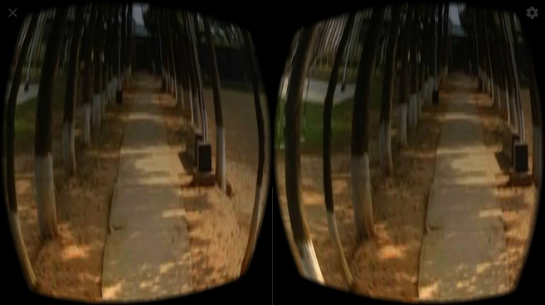
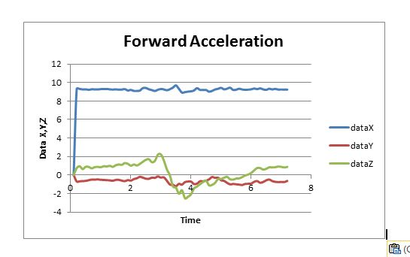
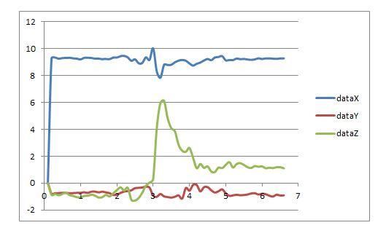
VISUAL RESULTS
Figure 22. Backward
Figure 23. Forward
Figure 24. Backward movement (over z-axis)
Figure 25. Forward movement (over z-axis)

Slide 21
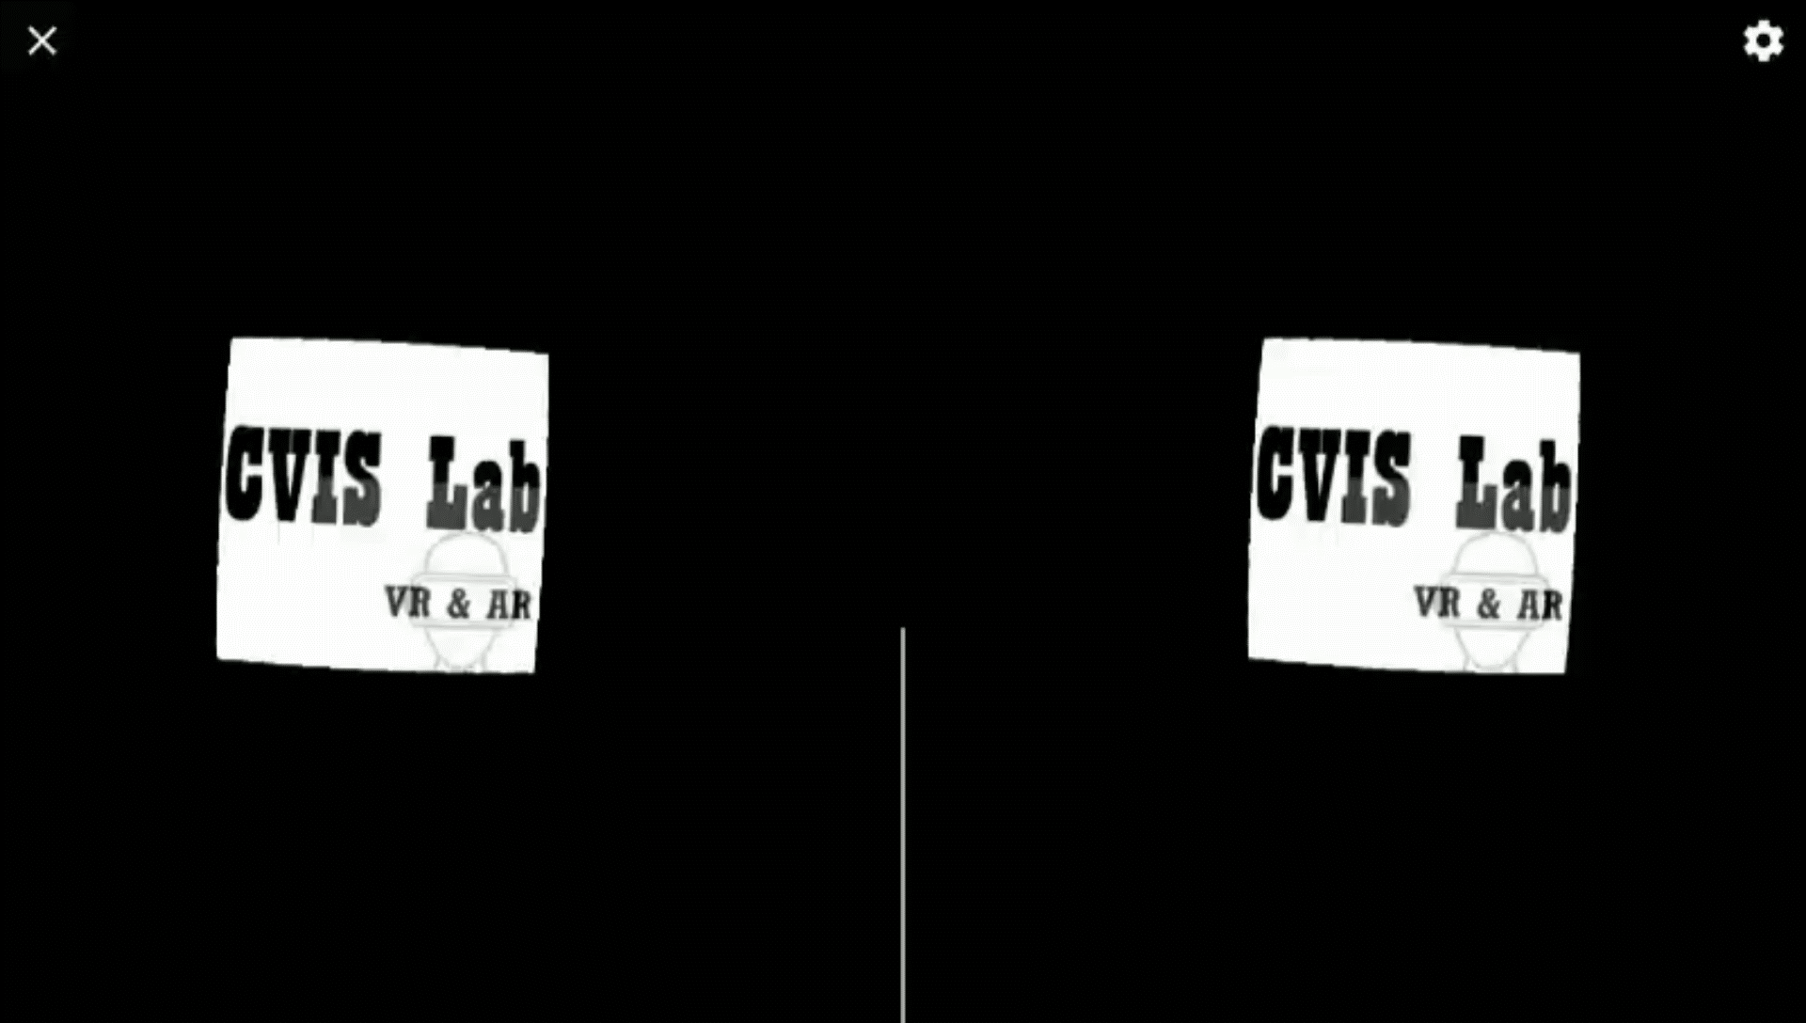
VISUAL RESULTS (REALTIME)

Slide 22

ACCURACY AND ANALYSIS
Depth calculation
dD= $\frac{dd∗D^2}{f∗T}$
Table 1. Depth Error
Disparity Error, dd (um) | Depth(m), D | Focal length, f(mm) | Baseline ,T (m) | Depth error (%)
1.4 | 10 | 14 | 0.024 | 9.7
1.4 | 15 | 17 | 0.033 | 3.75
1.4 | 11 | 23.5 | 0.029 | 3.25
1.4 | 19 | 24 | 0.026 | 5

Slide 23
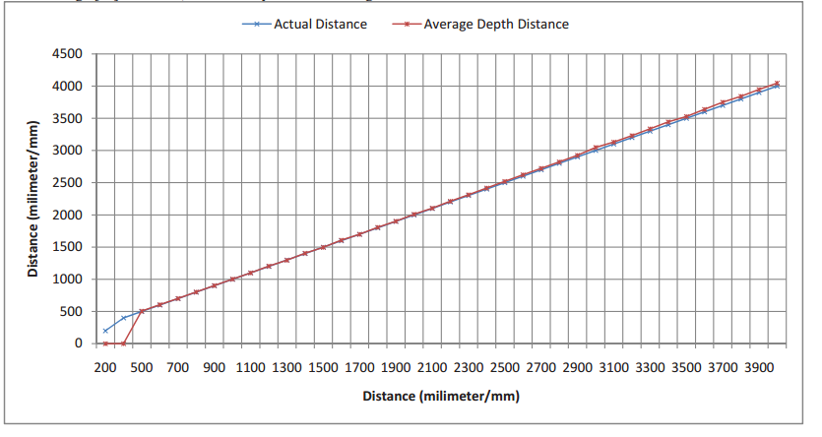
COMPARISON ANALYSIS
Figure 26. Comparisons between Average Depth Distance vs. Actual Depth Distance

Slide 24
COMPARISON ANALYSIS
USING OUR NAVIGATION MODEL FOR SMARTPHONES | OCULUS RIFT & HTC VIVE NAVIGATION
Uses internal sensors (accelerometer) | Uses external sensors (long range IR sensor)
Reads movement of the wearer | Reads position and movement of the wearer
Takes movement over one axis with respect to other axis while at rest | Reads position therefore takes 3-dimensional movement reading
Low cost | Expensive

Slide 25
FUTURE WORK
3D Modeling from the computer generated depth image
GPU parallel processing for converting 2D image to 3D model
Movement on the 3D models via sensors.
Navigation for left and right forward and backward movement
Solve many real life problems regarding investigations, education, entertainment

Slide 26
REFERENCE
Gemshein, H., & Gemshein, A. (1969). The History of Photography from the Camera Obscura to the Beginning of the Modern Era. NY, McGraw-Hill
Makhzani Niloufar, Kok-Why Ng, and Babaei Mahdi, “DEPTH-BASED 3D ANAGLYPH IMAGE MODELING,” International Journal of Scientific Knowledge, vol. 4, Mar. 2014.
J. Ko, M. Kim, and C. Kim, “2D-to-3D stereoscopic conversion: depth-map estimation in a 2D single-view image,” Applications of Digital Image Processing XXX, 2007.
Z. Ganatra and R. Chavda, International Journal of Innovations & Advancement in Computer Science. 2014.
Ke Lu, Xiangyang Wang, Zhi Wang and Lei Wang, "Binocular stereo vision based on OpenCV", IET International Conference on Smart and Sustainable City (ICSSC 2011), 2011.
Arts.rpi.edu,2018.[Online].Available:http://www.arts.rpi.edu/~ruiz/stereo_history/Howtomake3D.htm. [Accessed: 19- Jul- 2018].
Z. Lu, S. Rehman, M. Khan and H. Li, "Anaglyph 3D Stereoscopic Visualization of 2D Video Based on Fundamental Matrix", 2013 International Conference on Virtual Reality and Visualization, 2013.
R. Hartley and A. Zisserman. Multiple View Geometry in Computer Vision. Cambridge University Press, New York, NY, USA, 2003.
M. Brown and D.G. Lowe. Automatic panoramic image stitching using invariant features. Int. J. Computer. Vision, 74(1):59–73, 2007.
A. Pradhan, A. Kr. Singh and S. Singh, "An Approach to Calculate Depth of an Object in a 2-D Image and Map it into 3-D Space", International Journal of Computer Applications, vol. 119, no. 15, pp. 27-32, 2015.

Slide 27


Slide 28


